Slide 1
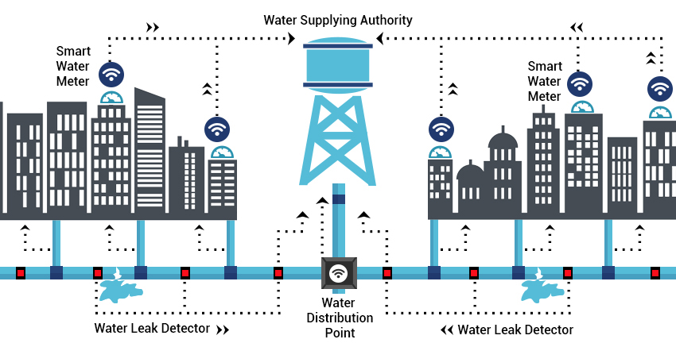
SMART MANAGEMENT OF WATER DISTRIBUTION SYSTEM
Done by:
Varun Bhaaskar
Shaik Ayisha Kareema
Yellamraju Venkata Naga Anjani Jyothi

Slide 2

INTRODUCTION
The need to supply water to the growing citizens is in the hands of government bodies.
Proper and accurate calculation and monitoring of water consumption is a laborious process.

Slide 3
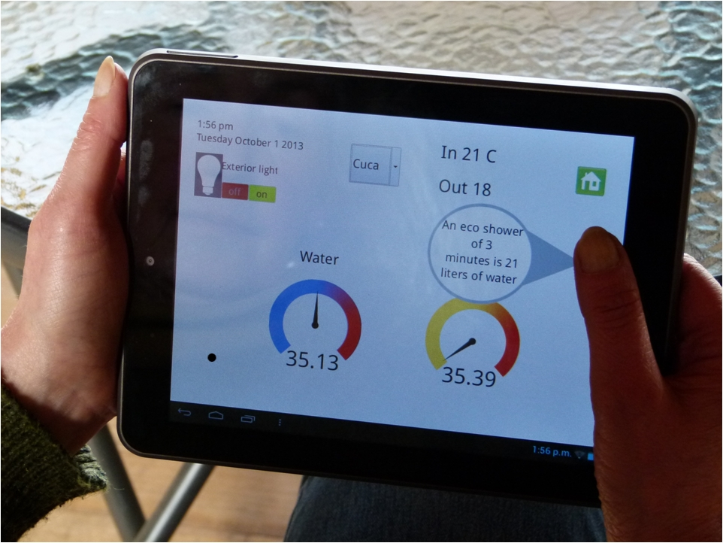
Through this proposal, we are suggesting a method of monitoring the usage of water and disseminate the data in the cloud.
As a result, the administrator can do a simple data analytics on the data for water management.
We conclude with the estimation of turnaround time for the plan of action when done manually and with the help of the technology.

Slide 4
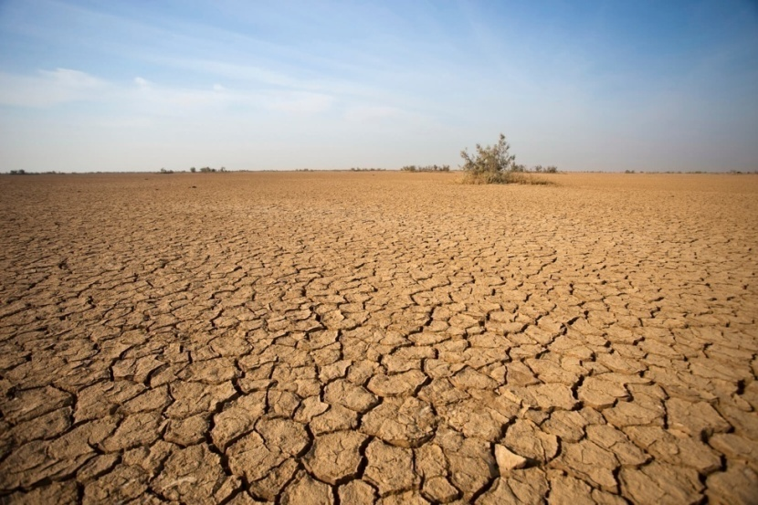
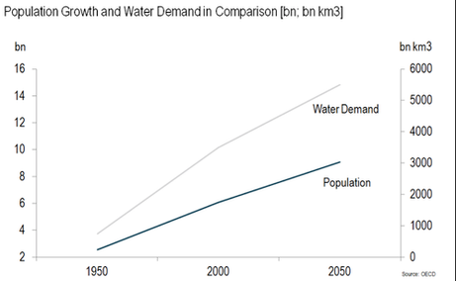
PROBLEM DISCUSSED
Water scarcity is the lack of sufficient available water resources to meet the demands of water usage within a region(especially in India where the population grows exponentially).
It is estimated that during the year 2025, 1.8 billon people including farmers may be affected by the water scarcity.

Slide 5
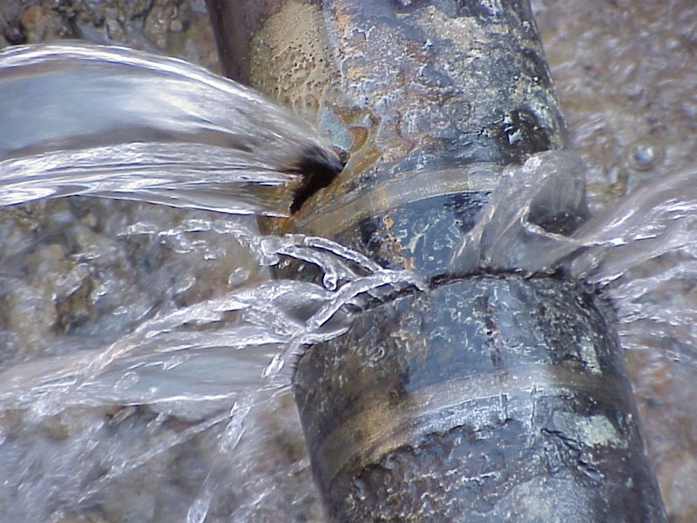
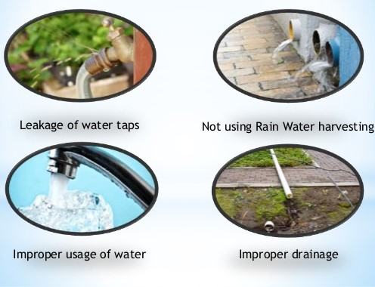
Lack of proper tools to analyze trends and behavior of people results in weak water distribution programs and plans.
On the other hand, the consumer lack proper tools to stay tuned and alerted to water consumption.

Slide 6
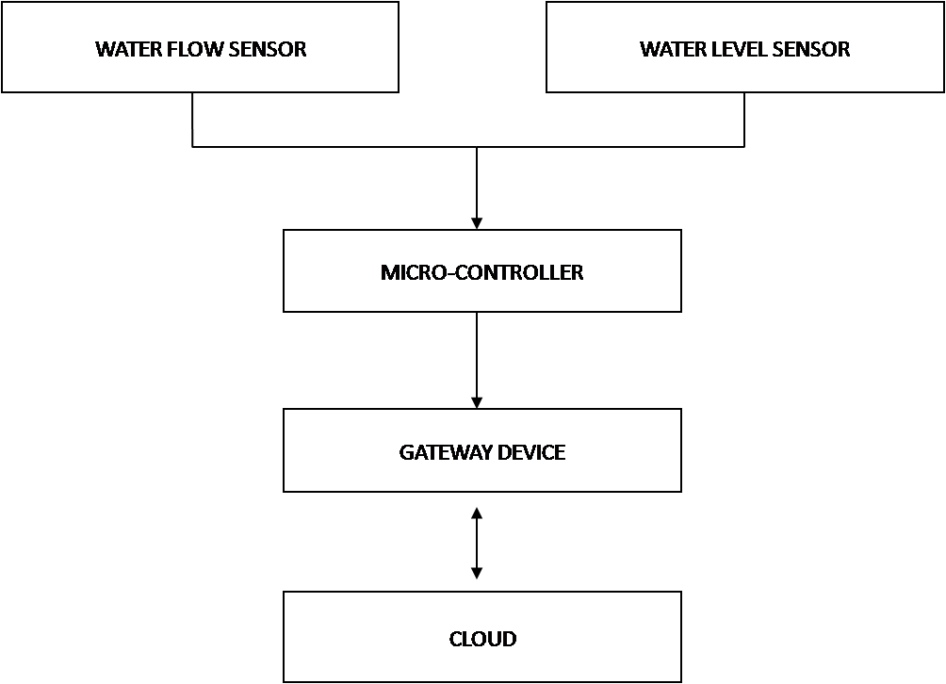
HOW IoT ASSISTS IN DETERMINING WATER DEMAND IN A CITY?
The Internet of Things as a technology holds great potential to solve “Water Scarcity” through smart, instant and predictable management.
With the help of IoT, water distribution, management and planning shall become more easy for the administrators for efficient results.
Also, we can monitor and transmit data, which could be stored in the cloud.

Slide 7
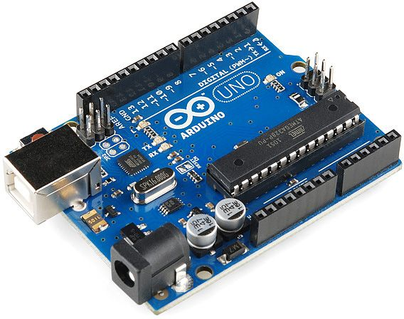
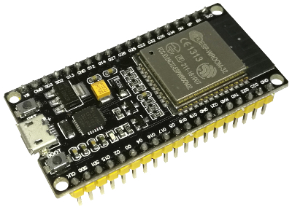
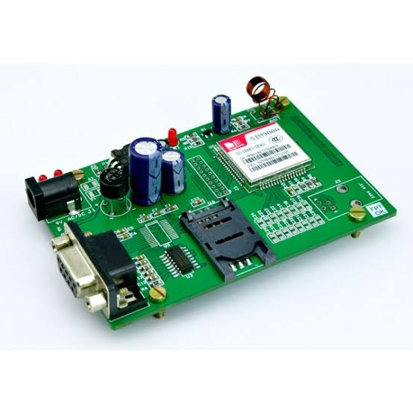
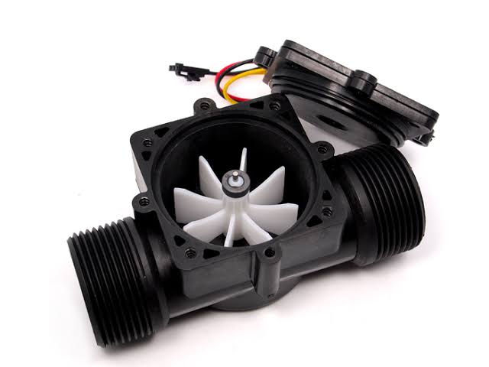
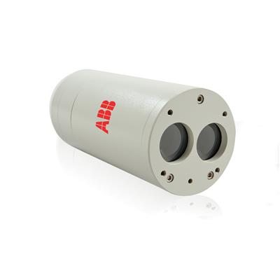
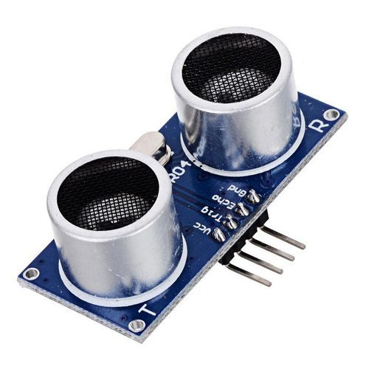
SOLUTION-COMPONENTS USED
The main components we would be making use of in our solution are:
Arduino Uno
GSM Module sim 900a / ESP8266 HDK
Ultrasonic sensor / LM200
Water flow sensor

Slide 8
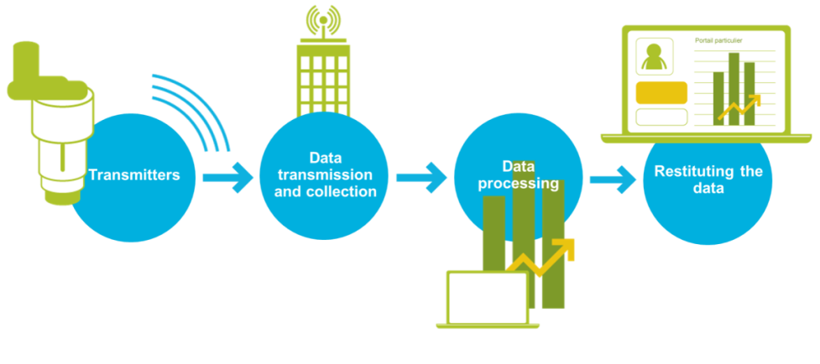
SOLUTION-DESCRIPTION
An Arduino Uno microcontroller is used to control the whole system.
It is interfaced with GSM modem and ultrasonic sensor.
The distance between the ultrasonic sensor and water is measured and the depth of the water is calculated.

Slide 9
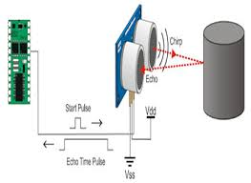
The ultrasonic source emits pulse of ultrasonic waves which is reflected at the surface of the water.
More the water in the tank, less time the ultrasonic waves gets reflected from the surface and vice-versa.
The time elapsed between the transmission and reception of the ultrasonic waves is measured.

Slide 10
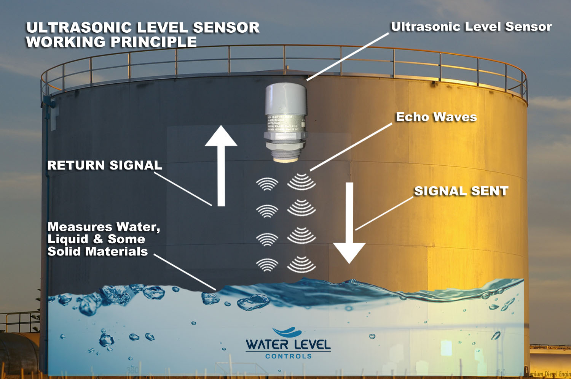
Controlling the level of water is also a subsystem of our solution.
The ultrasonic sensors are also used to switch ON/OFF the motor for pumping water.
When the water level is low as detected by the sensors, the Uno microcontroller is programmed to signal the motor for pumping.
When the water level is high as detected by the sensors, the motor is switched off.

Slide 11
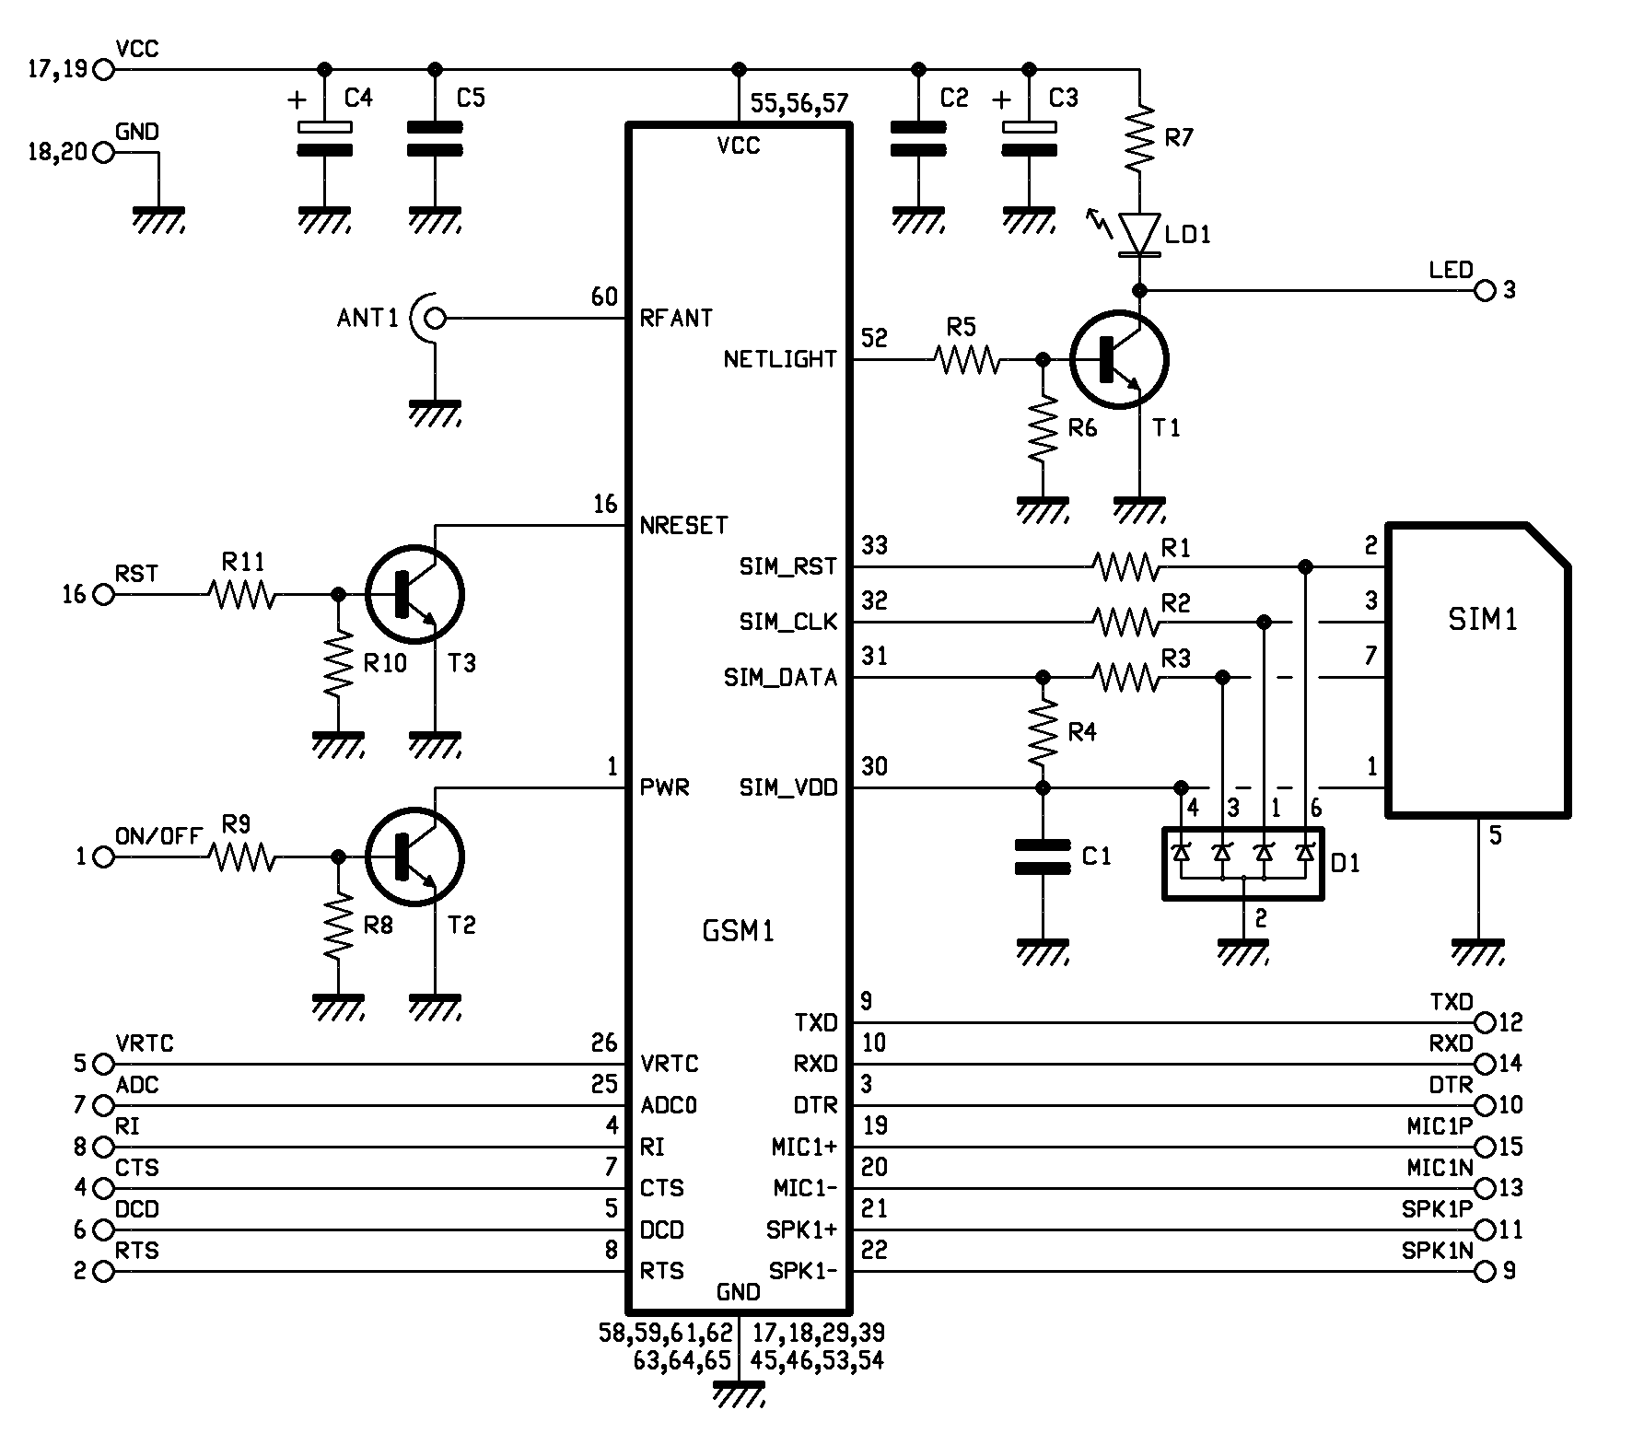
GSM Module sim 900a :
Advantage of using GSM module here is that it is economical and has less power consumption.
It is a wireless technology used for the transmission of the signal.
It is connected to one of the microcontroller board.
It will work for which it has been coded.
So whenever it receives signal from the sensor it transmitting the message to the control room

Slide 12
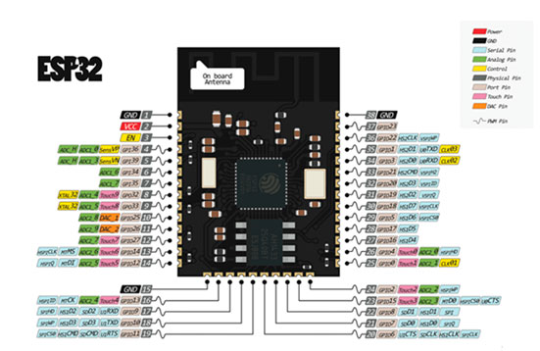
ESP8266 HDK :
The ESP8266 HDK (Hardware Development Kit) includes the chip ESP8266EX, the module ESP-WROOM-02 and the development board ESP-LAUNCHER.
ESP8266 offers a complete and self-contained Wi-Fi networking solution.
There are two of ways to work with your ESP8266 module,one way is using by the AT commands and the other way is by using the Arduino IDE.
It is connected to one of the microcontroller board.
It will work for which it has been coded.

Slide 13
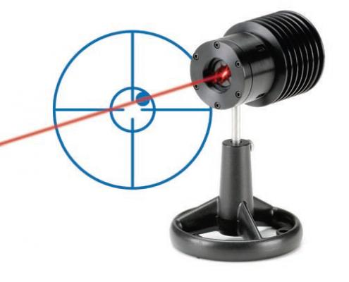
The LM200 Laser is a long range laser level transmitter.
It is high performance laser distance level and position sensor
It is a laser-based distance measuring instrument used in process control systems.
Arduino Uno calculates distance by multiplying the speed of light by the time it takes for a laser pulse to travel from the LM200 to a target and back.

Slide 14
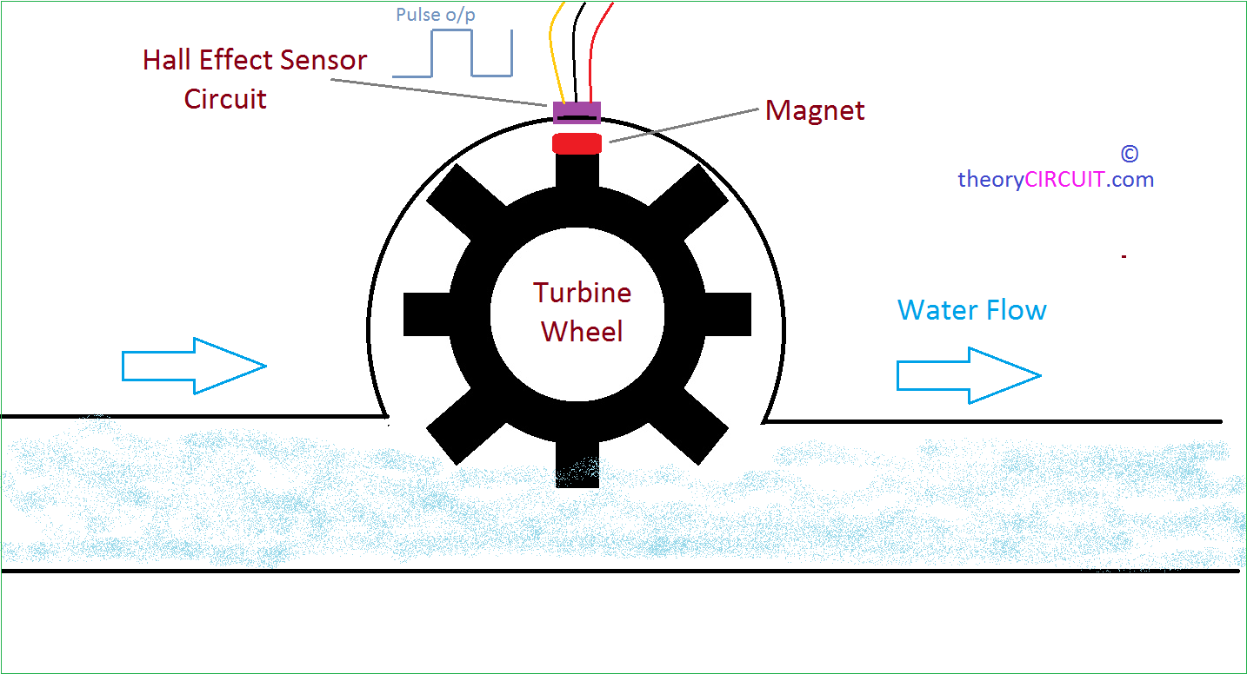
Water flow sensor consists of a plastic valve body, a turbine wheel and a hall-effect sensor.
Water flow sensor sits in line with the pipe-line and contains a pinwheel sensor.
There’s an integrated magnetic hall effect sensor that outputs an electrical pulse with every revolution.
The hall effect sensor is sealed from the water pipe and allows the sensor to stay safe and dry.
When water flows through the turbine, it rolls. Its speed changes with different rate of flow.

Slide 15
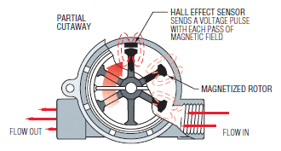
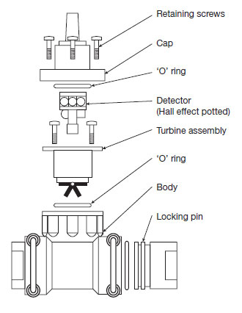
When water flows through the rotor of the water flow sensor, the rotor rolls. Then the hall-effect sensor outputs the corresponding pulse signal.
But, when there in no water flow through the pipeline, then the rotor stops rotating since the rate of flow of water is not as the expected value.
Hence, the hall-effect sensor cannot generate the corresponding output pulse signal which will be intimidated by our interface.

Slide 16
SOLUTION-WORKING
Two threshold values u1 and v1 represents upper and lower values respectively.
The values are chosen in such a way that upper threshold value is slightly lesser than the tank capacity(say 0.9) and lower threshold values is higher than the tank bottom(say 0.3).
The upper and lower threshold values are set and compared from the time delay of ultrasonic waves detected.
One should make sure that the tank should neither be empty nor the level of the water in the tank should be kept higher than the sediment height.

Slide 17
The time at which the tank is at the upper threshold value(u1) is measured as t1 and the time at which the lower threshold(v1) is detected as t2.
The difference between t1 and t2 is calculated and rate of consumption of water is also calculated.
These values are sent to the cloud storage.
int a=distance();
if (a >= 0.8*tank_height and a<= 0.75*tank_height){
"motor should be turned off";
timehigh= millis();
}
else if(a <= 0.1*tank_height and 0.5*tank_height){
"motor should be turned on";
timelow= millis();
}

Slide 18
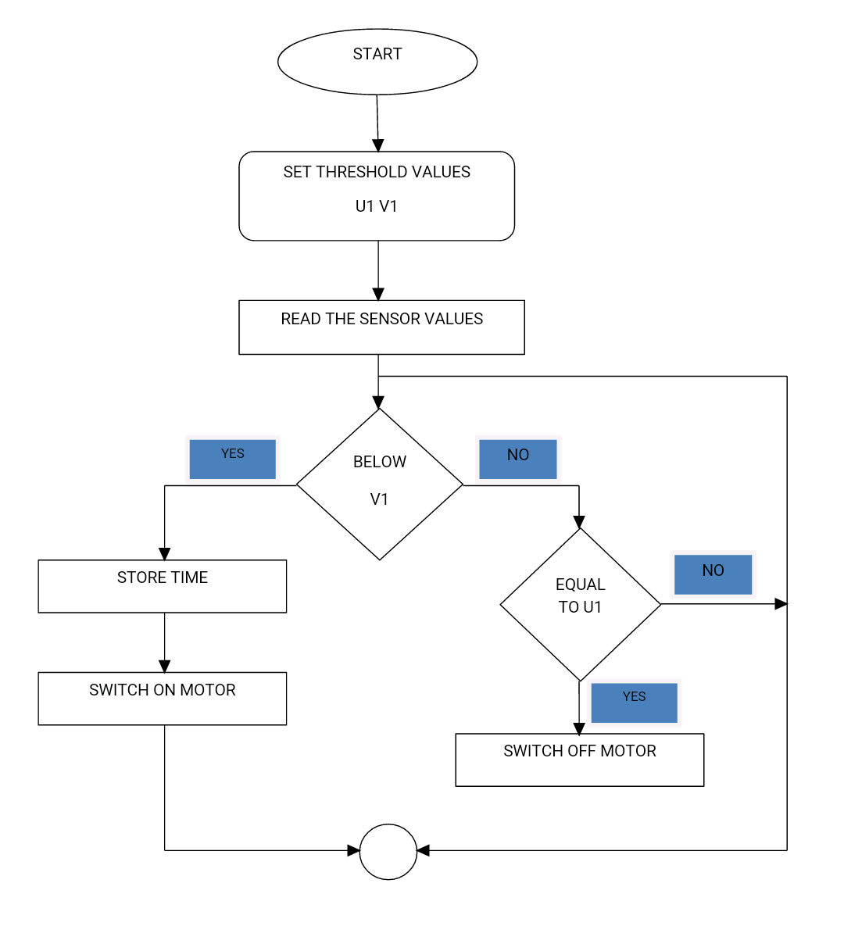

Slide 19
If the difference between time high and time low is positive, then we can obtain the fillrate which can be calculated by the formula,
fill rate = timehigh - timelow
And, if the difference is negative then we can get to know the discharge rate of the tank using,
discharge rate = timelow - timehigh
Water consumed from the tank per day during a particular interval of time by one family can be calculated and designated as the average consumption of the locality.
The expected consumption rate is the water consumed from the tank per day by the locality which can be calculated by,
water consumed by one family * total no of families which consumed water supplied by that tank / 24
The expected consumption can be obtained from the expected consumption rate by,
expected consumption rate * discharge rate

Slide 20

Each tank in each area is programmed an identification code which is sent along with the data(MAC address is mapped).
The administration department officials can then look into the data and the system present a simple data visualization about the water consumption.
The data visualization approach is as shown:

Slide 21
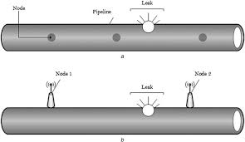
Consider multiple water flow sensors connected in a pipeline at a finite distance between them.
If all the sensors are giving the expected output, then we can observe that there is no leak or block near that particular sensor and that the flow of water is smooth.
Suppose, if any sensor(say the last sensor connected) doesn’t give us the desired output pulse signal, then one can assume that there is some misfunction between the last sensor and its respective preceding sensor.
This misfunction maybe due to the leak or block of waterflow in the pipeline.
The IP address of the sensor is obtained and with the help of this, the user can locate the exact area of leakage of water.
SENSOR
LEAK
PIPELINE
SENSOR 1
SENSOR 2
LEAK

Slide 22
CONCLUSION
Our solution is an outcome of the experimentation with the Arduino Uno microcontroller with ultrasonic sensor using IoT Technology to measure the water consumption in the overhead tanks of a region.
We have also extended our solution by presenting additional data to the end user such as leakage of water.

